Slide 1
On Traffic-Aware Partition and Aggregation in MapReduce for Big Data Applications

Slide 2
INTRODUCTION
MapReduce has emerged as the most popular computing framework for big data processing due to its simple programming model
MapReduce is a programming model based on two primitives: map function and reduce function.
In the map phase, map tasks are launched in parallel to convert the original input splits into intermediate data in a form of key/value pairs. These key/value pairs are stored on local machine and organized into multiple data partitions, one per reduce task.
In the reduce phase, each reduce task fetches its own share of data partitions from all map tasks to generate the final result.

Slide 3
ABSTRACT
The MapReduce programming model simplifies large-scale data processing on commodity cluster by exploiting parallel map tasks and reduce tasks. Although many efforts have been made to improve the performance of MapReduce jobs, they ignore the network traffic generated in the shuffle phase, which plays a critical role in performance enhancement.
In this project, we study to reduce network traffic cost for a MapReduce job by designing a novel intermediate data partition scheme.

Slide 4
EXISTING SYSTEM
Traditionally, A hash function is used to partition intermediate data among reduce tasks, which, however, is not traffic-efficient because network topology and data size associated with each key are not taken into consideration.
Existing MapReduce-like system to decrease the traffic by pushing aggregation from the edge into the network. However, it can be only applied to the network topology with servers directly linked to other servers, which is of limited practical use.

Slide 5
Limitations of Existing System:
It leads to large network traffic because it ignores network topology and data size associated with each key.

Slide 6
PROPOSED SYSTEM
we jointly consider data partition and aggregation for a Map Reduce job with an objective that is to minimize the total network traffic.
In this project, we propose a distributed algorithm for big data applications by decomposing the original large-scale problem into several sub problems that can be solved in parallel.
An online algorithm is designed to deal with the data partition and aggregation in a dynamic manner.

Slide 7
Advantages of Proposed system:
Each aggregator can reduce merged traffic from multiple map tasks. It is designed to adjust data partition and aggregation in a dynamic manner.
It can significantly reduce network traffic cost in both offline and online cases.

Slide 8
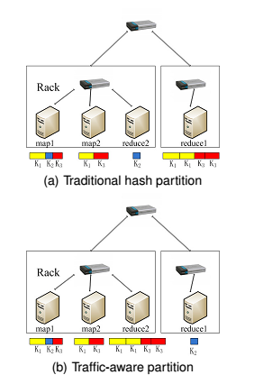
SYSTEM ARCHITECTURE

Slide 9
IMPLEMENTATION
In this project we have 3 modules,
1. Upload Module
2. MapReduce Aggregation Module
3. Graph Module

Slide 10
Module Description:
Upload:
In this module, we can upload the documents to transfer through the network.
MapReduce Aggregation:
In this Module, input data has been processed by the reducer which is nearer to the mapper location. After completion of Processing it will display the aggregated data to the network user.

Slide 11
Graph:
This graph represents network traffic cost for no aggregation processing time and aggregation processing time.

Slide 12
SYSTEM CONFIGURATION
Hardware Configuration:
System : Pentium IV 2.4 GHz.
Hard Disk : 40 GB.
Floppy Drive : 1.44 Mb.
Monitor : 15 VGA Colour.
Mouse : Logitech.
Ram : 512 Mb.

Slide 13
Software Configuration:
Operating system : Windows XP/7.
Coding Language : JAVA
Frontend : AWT, Swings
Backend : MySQL

Slide 14
UML Diagrams

Slide 15
Class Diagram:

Slide 16
Use Case Diagram:

Slide 17
Sequence Diagram:

Slide 18
Collaboration Diagram:

Slide 19
Component Diagram:

Slide 20
Deploymet Diagram:

Slide 21
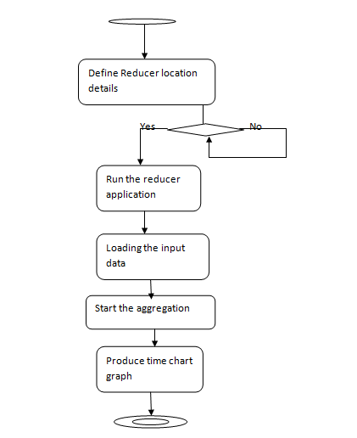
Activity Diagram:

Slide 22
SCREEN SHOTS

Slide 23
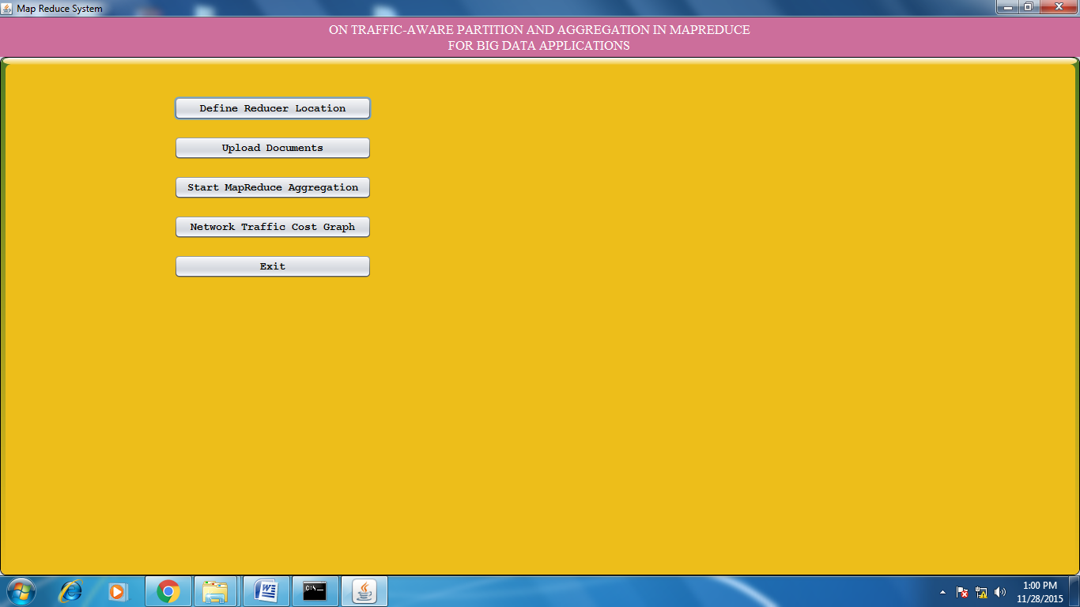
Mapper Application Home Page:

Slide 24
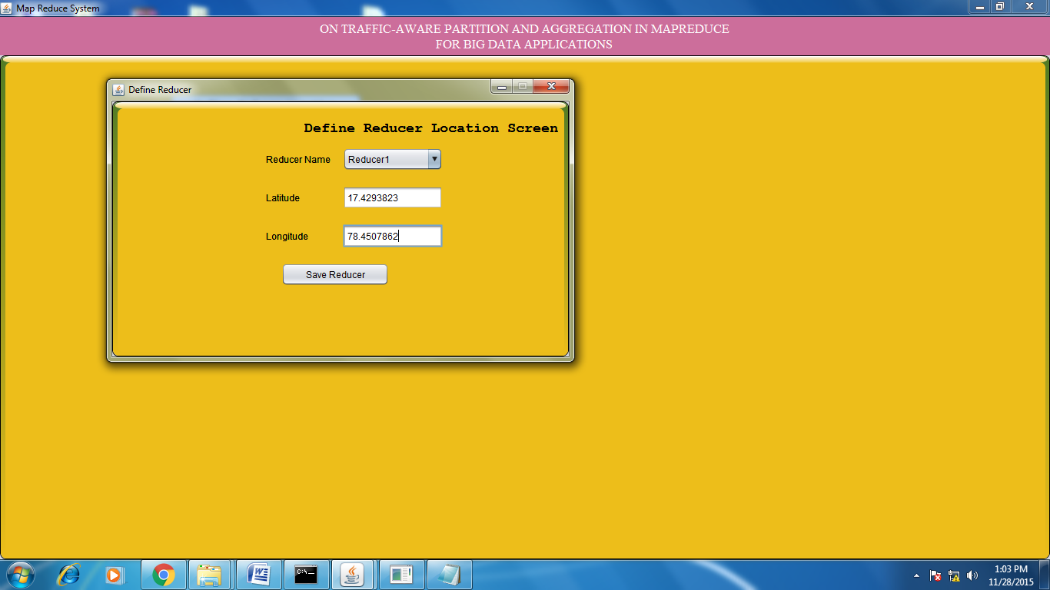
Define Reducers:

Slide 25
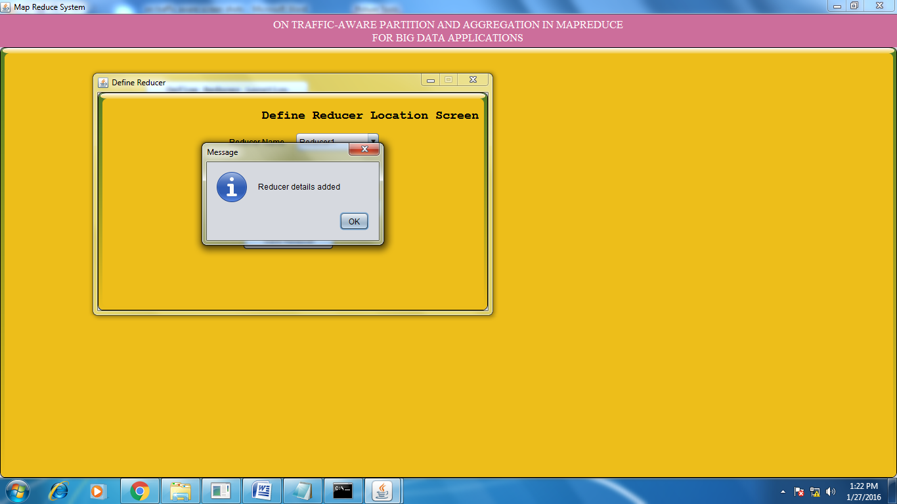
After Successfully define Reducer 1:

Slide 26
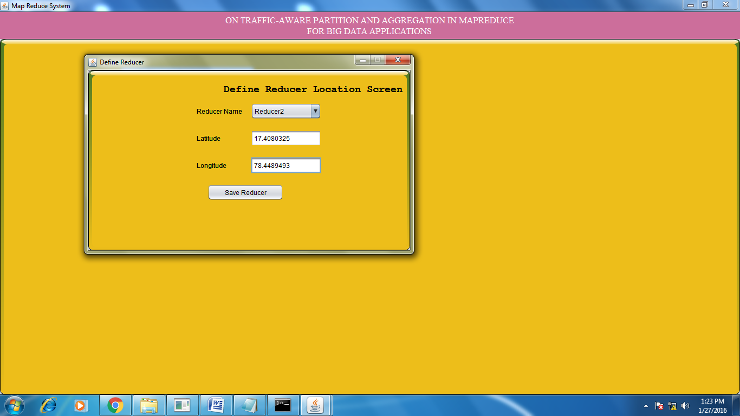
Define Reducer 2:

Slide 27
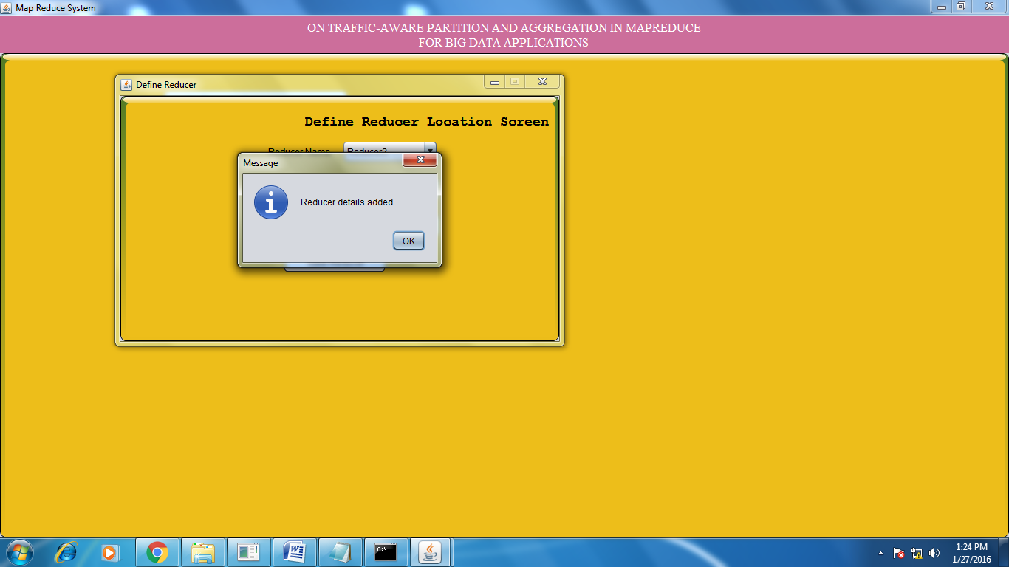
After Successfully define Reducer 2:

Slide 28
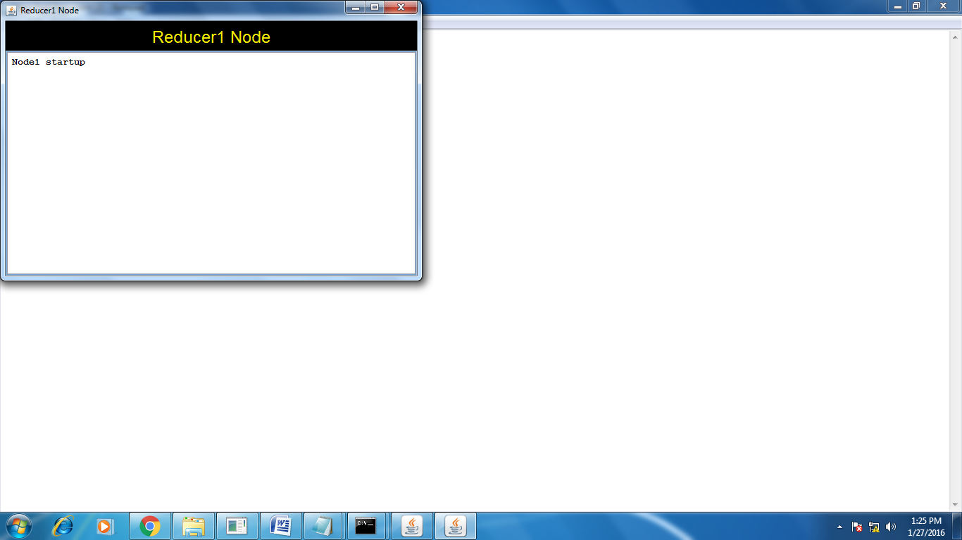
Run the Reducers:

Slide 29
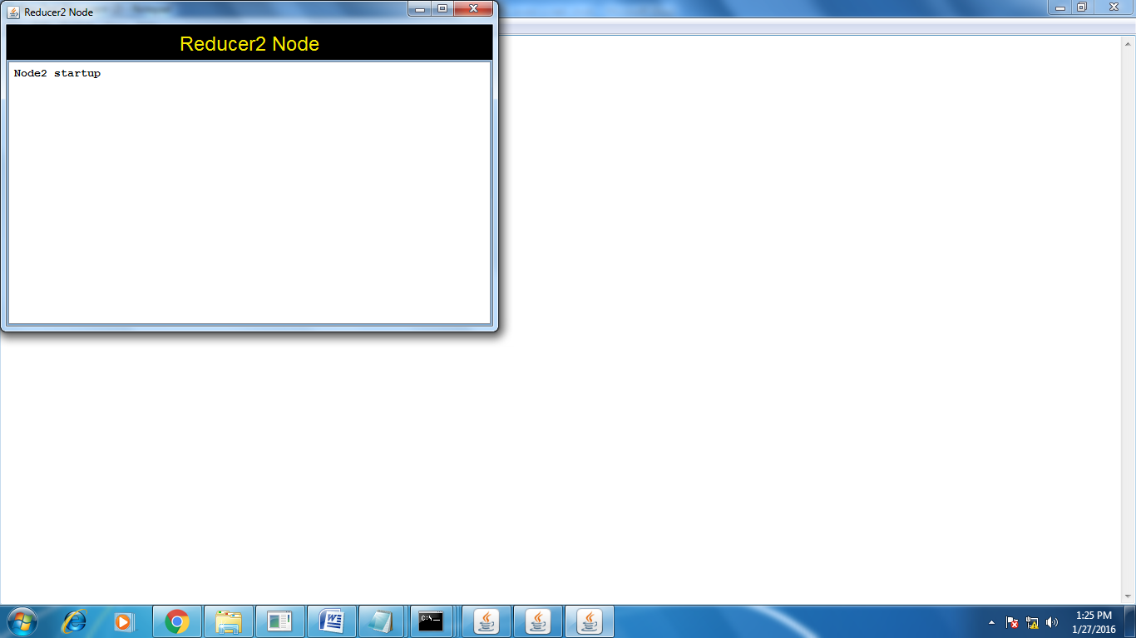

Slide 30
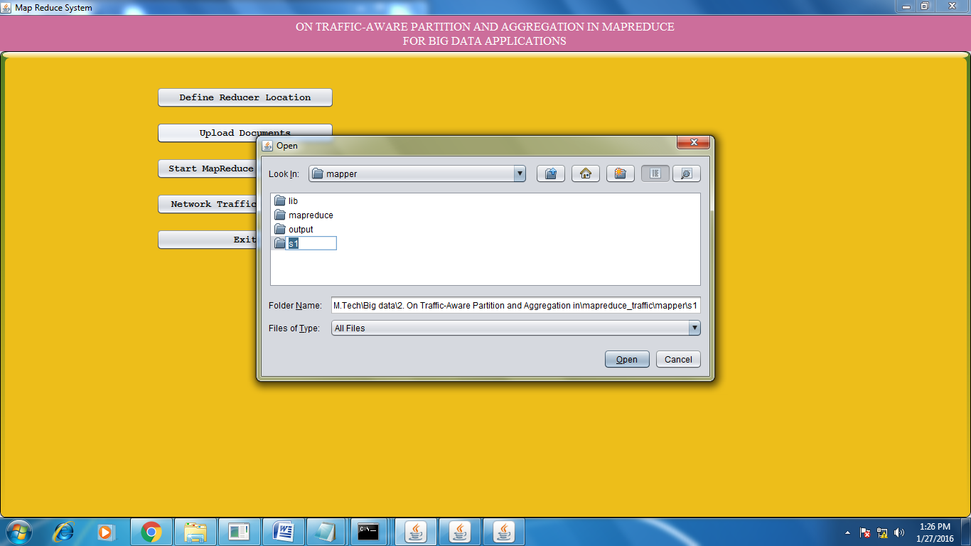
Uploading Documents:

Slide 31
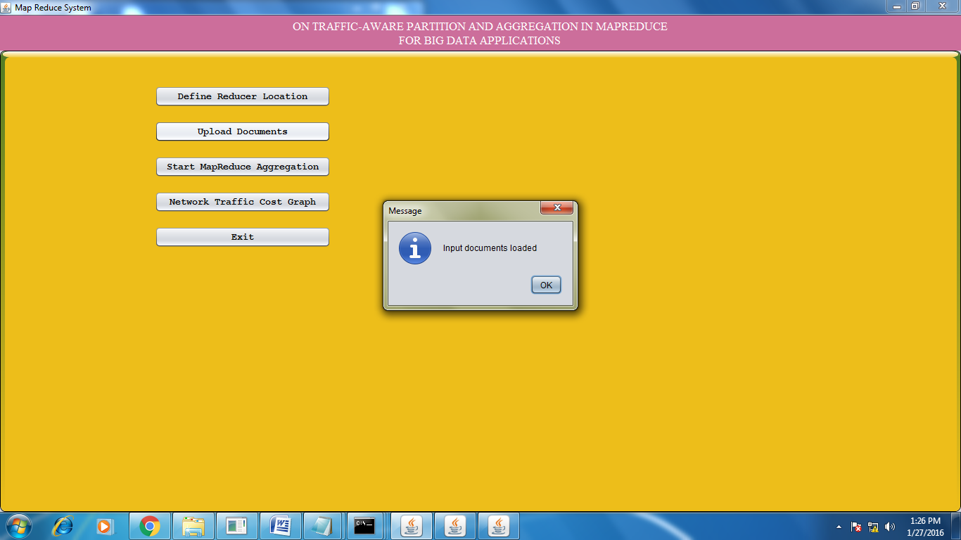
After Loading Document:

Slide 32
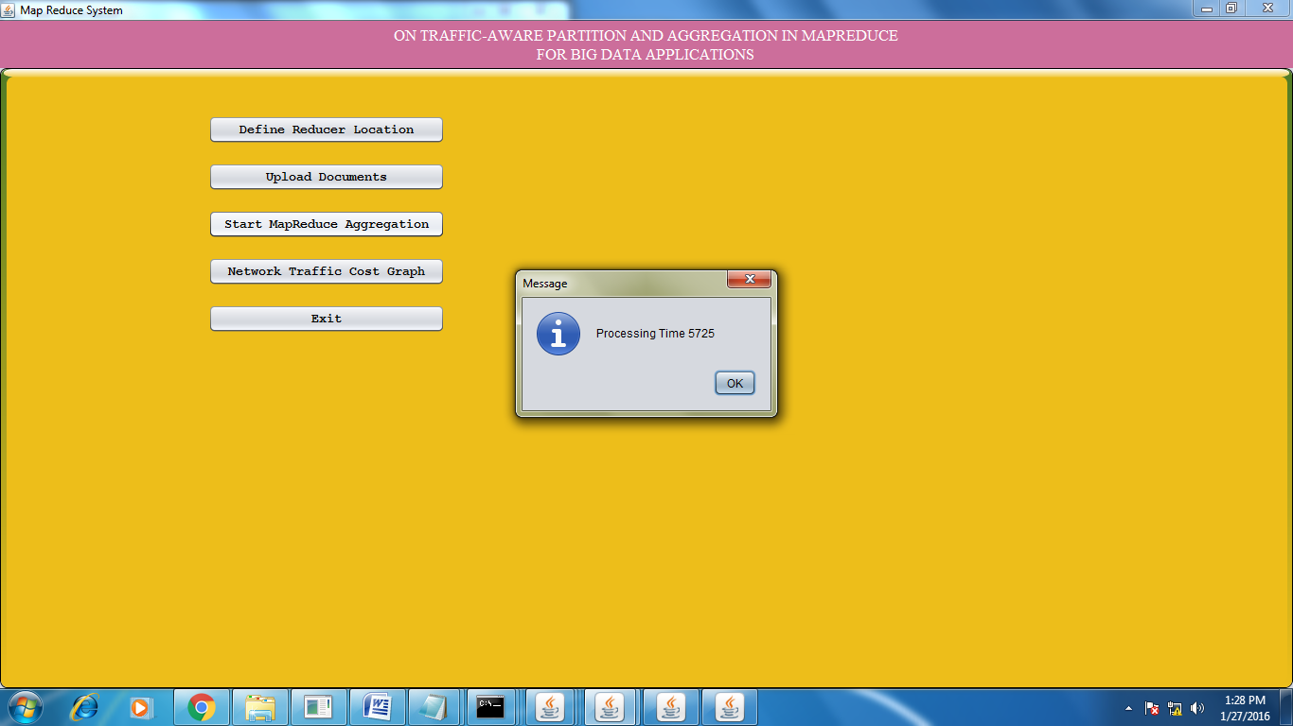
Start MapReduce Aggregation:

Slide 33
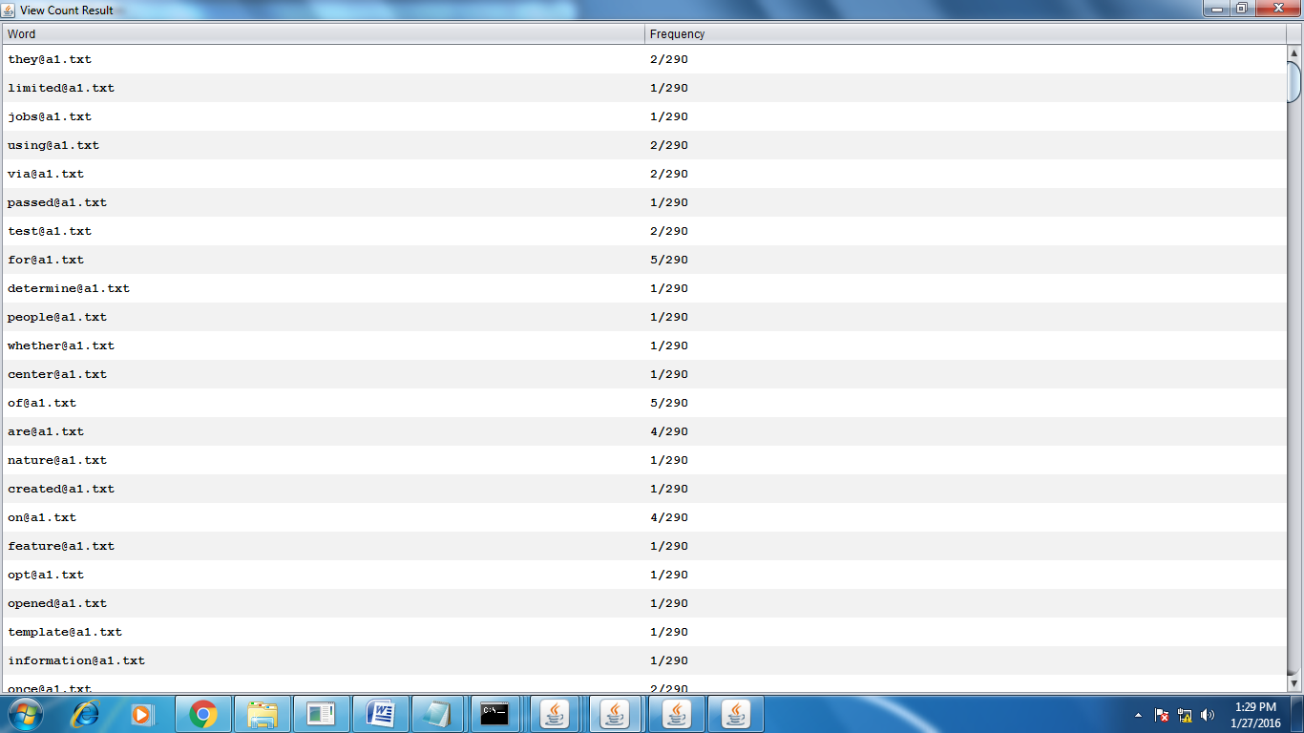
View Aggregated data:

Slide 34
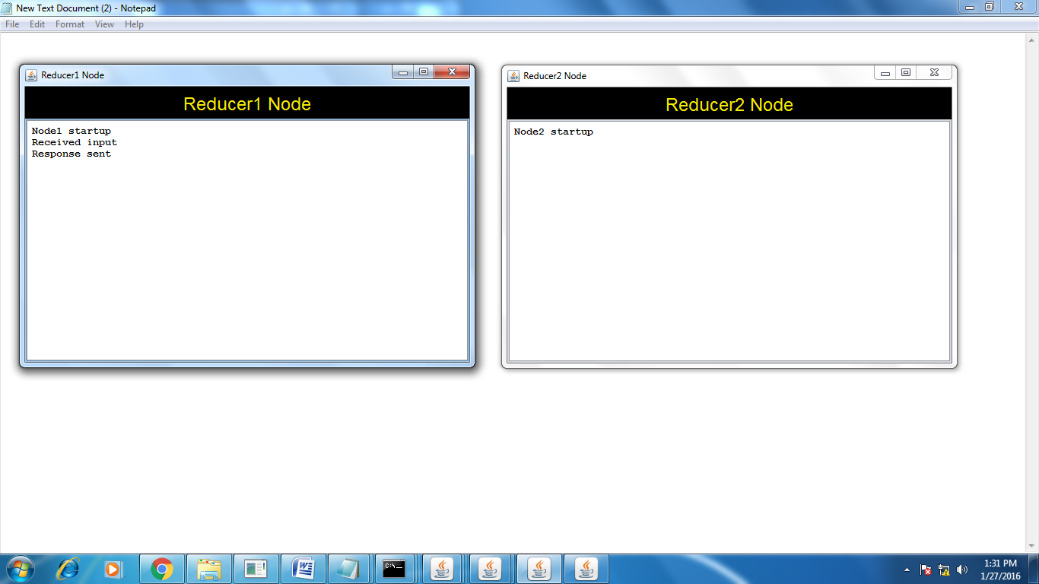

Slide 35
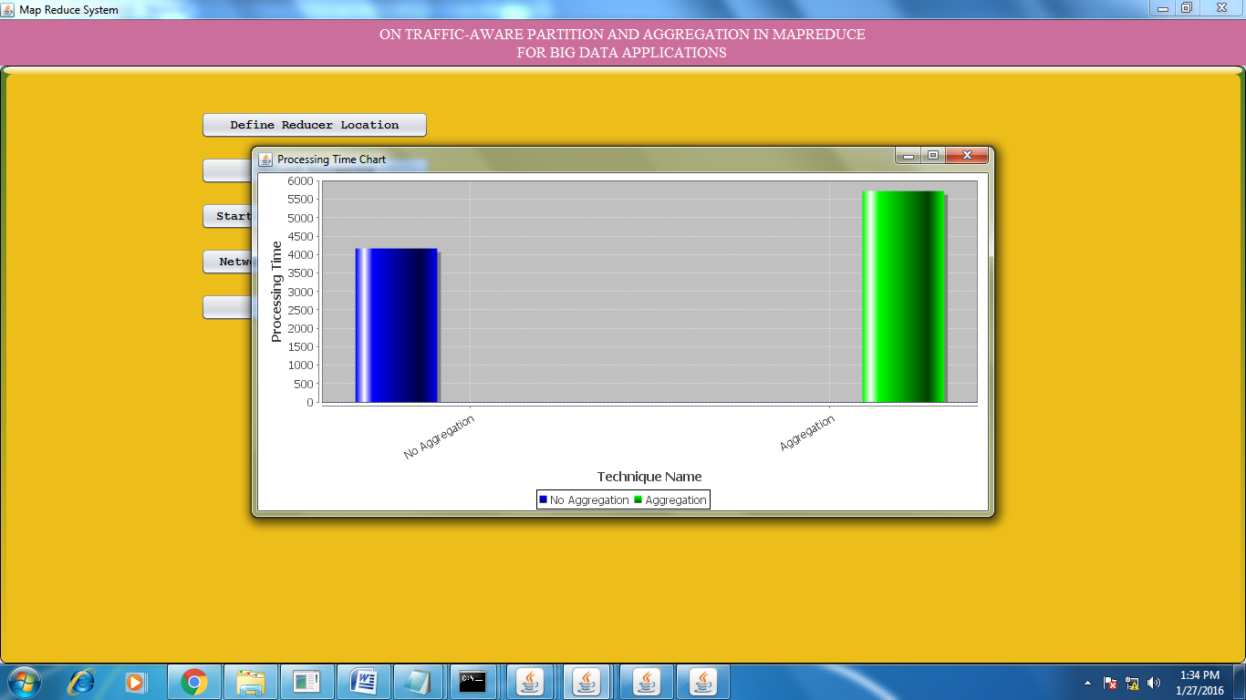
Network Traffic Cost Graph:

Slide 36
CONCLUSION
In this project, we study the joint optimization of intermediate data partition and aggregation in MapReduce to minimize network traffic cost for big data applications. We propose a three-layer model for this problem and formulate it as a mixed-integer nonlinear problem, which is then transferred into a linear form that can be solved by mathematical tools. To deal with the large-scale formulation due to big data, we design a distributed algorithm to solve the problem on multiple machines.

Slide 37
REFERENCES
[1] J. Dean and S. Ghemawat, “Mapreduce: simplified data processing on large clusters,”, 2008.
2] W. Wang, K. Zhu, L. Ying, J. Tan, and L. Zhang, “Map task scheduling in mapreduce with data locality: Throughput and heavy-traffic optimality,”,2013.
[3] F. Chen, M. Kodialam, and T. Lakshman, “Joint scheduling of processing and shuffle phases in mapreduce systems,”, 2012.

